Slide 1

Azure Functional
Author: Chien.Do

Slide 2



TABLE OF CONTENTS
01.
04.
WHAT IS AZURE
FUNCTION ?
APPLICATION SETTINGS
02.
05.
TRIGGERS
DEMO
03.
06.
BENEFITS
Q&A

Slide 3



WHAT IS
AZURE FUNCTION ?

Slide 4
WHAT IS AZURE FUNCTION ?
Function as a Service
Azure Function = Code + Events
Support different programming language

Slide 5




Triggers
Timer
Queue Message
HTTP Request
TRIGGERS
More: CosmosDB trigger, Azure Blob, Send Grid, etc.

Slide 6
Built-in Middleware
Middleware | Description
Authentication | Adds authentication support.
CORS | Configures Cross-Origin Resource Sharing.
Routing | Adds routing capabilities for MVC or web form
Session | This middleware provides the support for maintain or manage user login sessions.
StaticFiles | Adds support for serving static files and directory browsing.

Slide 7
App.Run(), App.Use(), App.Map()
Run is terminate chain. No other middleware will call after this.
Use is used to configure multiple middleware. We can include next parameter which calls the next middleware.
Map is used as a convention for branching the pipeline. Map branches the request pipeline based on matches of the given request path. If the request path starts with the given path, the branch is executed.

Slide 8
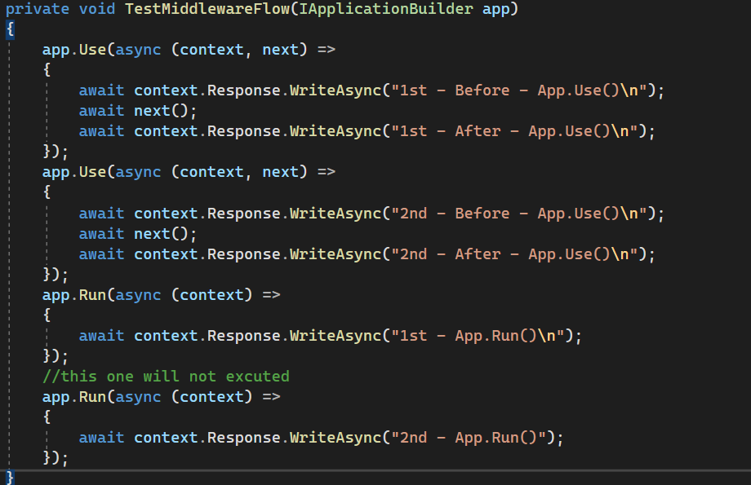
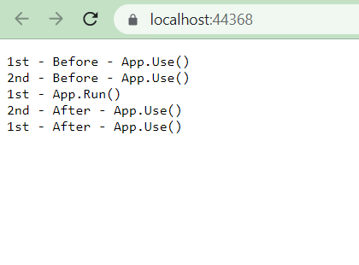
App.Run(), App.Use()

Slide 9
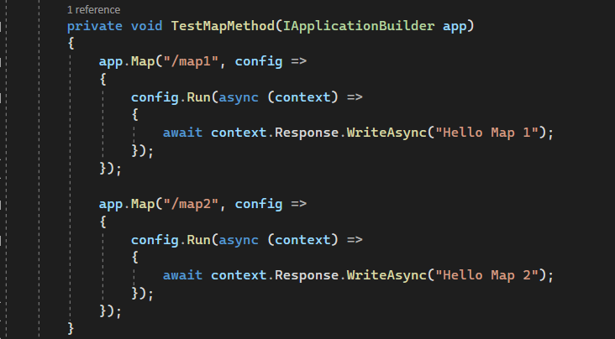
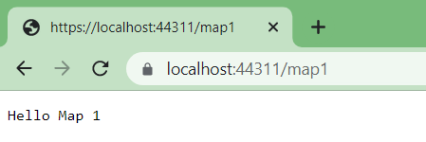
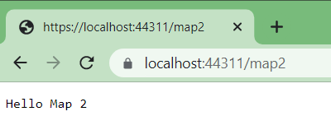
App.Map()

Slide 10
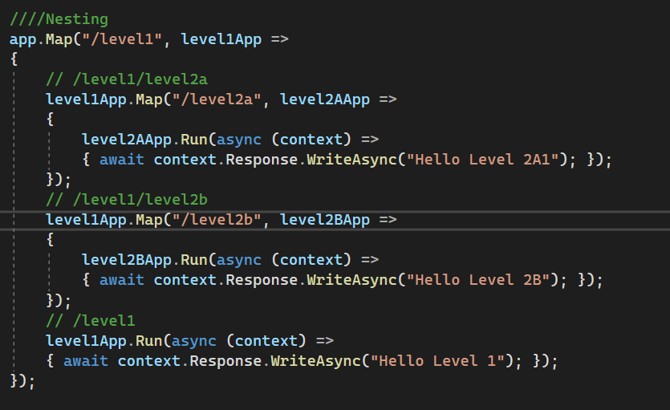
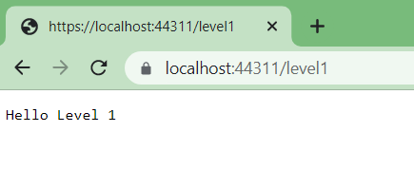
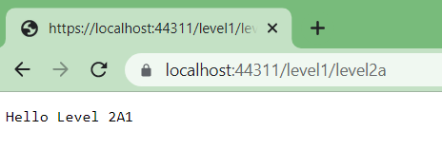
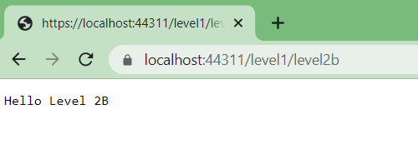
App.Map()
Notes:
Support nesting

Slide 11
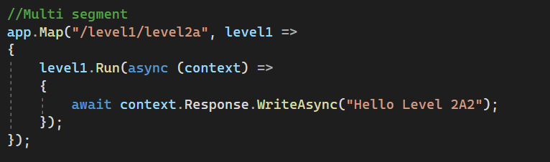
App.Map()
Notes:
Support nesting
If Implement branch for nesting and multi segment, based on the order that the middleware will be triggered

Slide 12
App.UseWhen() & App.MapWhen()
Also branches the request pipeline based on the result of the given predicate.
Unlike MapWhen, UseWhen branch is rejoined to the main pipeline if it doesn't short-circuit or contain a terminal middleware.
Notes:
Short ciruit: mean terminate the pipeline as we want ( By use App.Run or not call Next parameter)

Slide 13
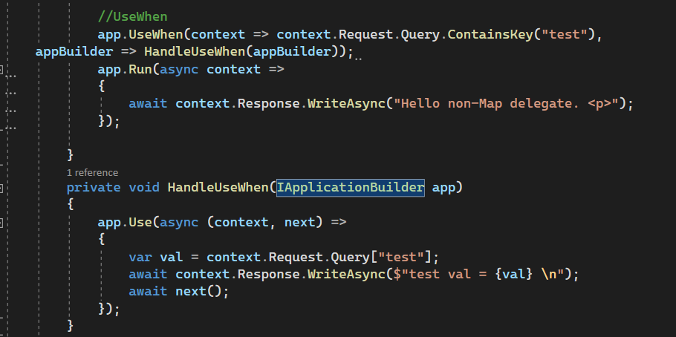
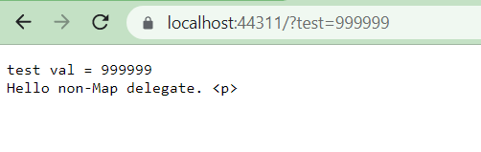
App.UseWhen()

Slide 14
CUSTOM MIDDLEWARE

Slide 15
CUSTOM MIDDLEWARE
We can create custom middleware and trigger in pipeline.
Middleware class must have :
Public constructor with a parameter of type “RequestDelegate”.
Public method named Invoke or InvokeAsync. This method must return Task and Accept first parameter of type HttpContext

Slide 16
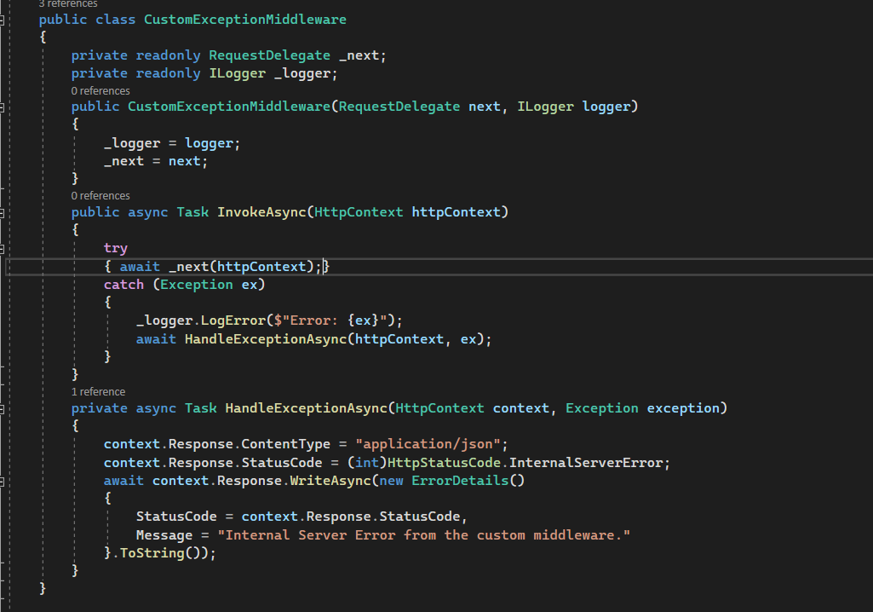
CUSTOM MIDDLEWARE

Slide 17
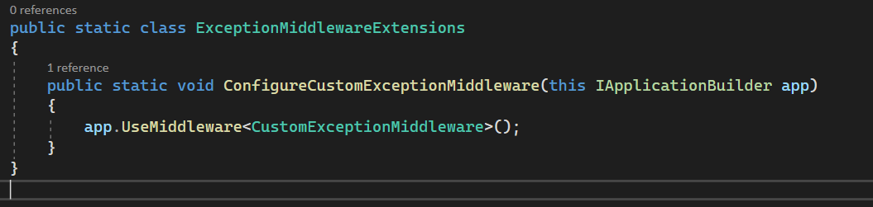
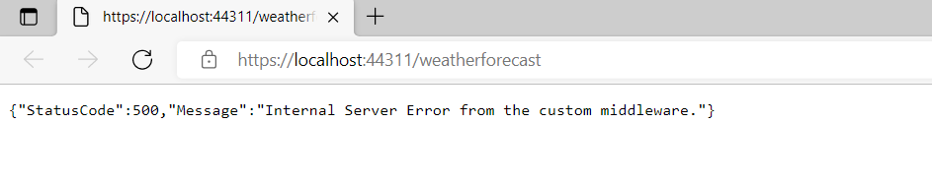
CUSTOM MIDDLEWARE

Slide 18
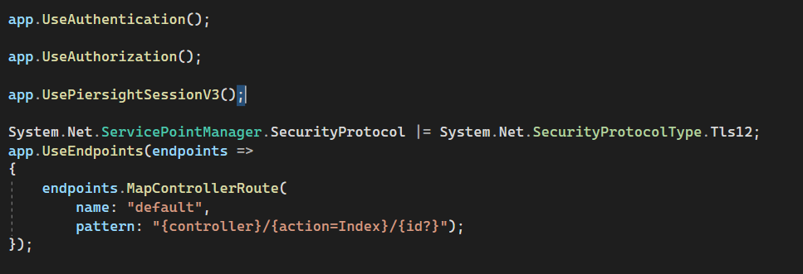
CUSTOM MIDDLEWARE - PRACTICAL APPLICATION

Slide 19
CUSTOM MIDDLEWARE - REWRITE URL
Rewrite URL
Changes the current request's path internally
Continues processing the current request
Keep request information
context.Request.Path
Redirect URL
Fire new request on the server
Terminate the pipeline
Reissued to GET
context.Response.Redirect()
URL rewriting is the act of modifying request URLs based on one or more predefined rules.
URL rewriting is valuable in several scenarios such as :
Re-linking legacy content
Creating 'prettier URLs'
Handling custom URLs that need to actually process something else
Redirecting from one Operation to another as part of Application code
Notes:
URL rewriting is the concept of changing the currently executing URL and pointing it at some other URL to continue processing the current request or redirecting to an external URL.
2. For redirect, it will terminate the pipeline ( and change display URL)
3. For rewrite URL, if we have POST or PUT operation that have data associated with, the data is stay.
4. For Redirect URl, it will be good when target to the external URL

Slide 20
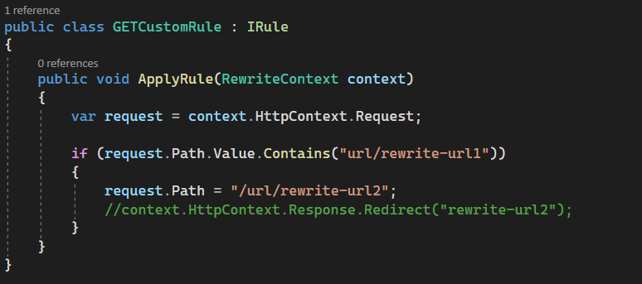
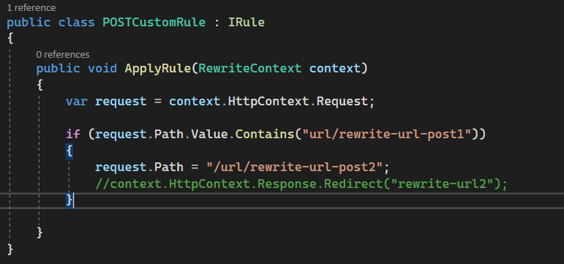
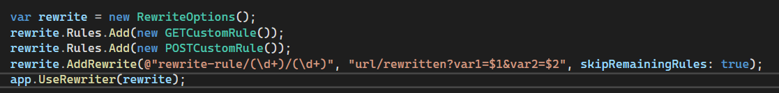
REWRITE URL - Rule

Slide 21
ASP.NET CORE
FILTERS

Slide 22
ASP.NET CORE FILTERS
Filter allow us to custom code before or after executing method.
Filters are invoked on certain stages in the request pipeline.
Filter support both synchronous and asynchronous.

Slide 23
FILTER TYPES
Authorization
Resource
Action
Exception
Result

Slide 24
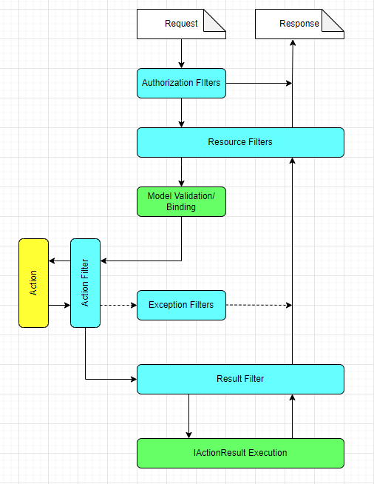
FILTER PIPELINE
Run First.
If the request not authorized, it will short-circuit pipeline
Also run at the end of pipeline after the result has been executed.
Run next before model binding
If an exception occur somewhere in the pipeline, this one will execute
Run before and after action method executes.
Can use them to customize the arguments
If the action method return an IActionResult. This one will execute before and after the IActionResult is executed

Slide 25
AUTHORIZATION FILTERS
Are the first filters run in the filter pipeline.
Control access to action methods.
Have a before method, but no after method.
NOT throw exception inside because :
The exception will not be handled.
Exception filters will not handle the exception.
Notes:
Authorization filters run first in the MVC filter pipeline, before any other filters. They control access to the action method by immediately short-circuiting the pipeline when a request doesn’t meet the necessary requirements.

Slide 26
RESOURCE FILTERS
ConsumesAttribute [Consumes("application/ json")]
Can be used to restrict the allowed formats an action method can accept
Will short-circuit the pipeline and return a 415 Unsupported Media Type response
DisableFormValueModelBindingAttribute
Prevents model binding from binding to form data in the request body
Run before model binding, so you can disable the model binding
Run after Authorization filters.
Can completely short-circuit the request pipeline and return a response directly
Prevent an action method from executing if an unsupported content type is requested.
Notes:
Look more example how to short-circuit
Can use resource filters for a wide range of purposes, thanks to the fact they execute so early (and late) in the filter pipeline.

Slide 27
ACTION FILTERS
Action filters do not apply to Razor Pages.
Action filters run just after model binding, before or after the action method executes.
Throwing an exception in an action method to prevents running of subsequent filters.
Let you manipulate the arguments to the method before it executes.
Notes:
IAsyncActionFilter
Thanks to this positioning, action filters can access all the arguments that will be used to execute the action method, which makes them a powerful way of extracting common logic out of your actions.
ValidateModelAttribute—This will return BadRequestResult if the model state indicates that the binding model is invalid and will short-circuit the action execution.

Slide 28
EXCEPTION FILTERS
Can be used to implement common error handling.
Should use middleware for exception handling. Use exception filters only where error handling differs based on which action method is called.
Exception filters can catch exceptions from more than your action methods. They’ll run if an exception occurs in the Filter pipeline:
During model binding or validation
When the action method is executing
When an action filter is executing
Notes:
IAsyncActionFilter
Don't have before and after events.
Are not as flexible as error handling middleware
Implement OnException or OnExceptionAsync.

Slide 29
RESULT FILTERS
Result filters are only executed when an action or action filter produces an action result.
Result filters are not executed when:
An authorization filter or resource filter short-circuits the pipeline.
An exception filter handles an exception by producing an action result.
Notes:
If everything runs successfully in the pipeline, and there’s no short-circuiting, then the next stage of the pipeline after action filters are result filters. These run just before and after the IActionResult returned by the Action method (or action filters) is executed

Slide 30
FILTERS SCOPE
Should Implement either the synchronous or the async version of a filter interface
If both asynchronous and synchronous interfaces are implemented in one class, only the async method is called.
A Filter can be added to to the pipeline at one of three scopes:
Using an attribute on a controller action. Filter attributes cannot be applied to Razor Pages handler methods.
Using an attribute on a controller
Globally for all controllers, actions
Notes:
By adding filters in different ways, you can achieve a number of different results. Imagine you have a filter that forces you to log in to view an action. How you add the filter to your app will significantly change your app’s behavior

Slide 31
DEFAULT ORDER OF EXECUTION
Global
OnActionExecuting
Controller
OnActionExecuting
Action
OnActionExecuting
Endpoint
Action
OnActionExecuted
Controller
OnActionExecuted
Global
OnActionExecuted

Slide 32
CONTROLLER LEVEL FILTERS
Every controller that inherits from the Controller base class includes OnActionExecuting, OnActionExecutionAsync, and OnActionExecuted methods. These methods:
Wrap the filters that run for a given action.
OnActionExecuting is called before any of the action's filters.
OnActionExecuted is called after all of the action filters.
OnActionExecutionAsync is called before any of the action's filters. Code in the filter after next runs after the action method.

Slide 33
CONTROLLER LEVEL FILTERS
Scenario:
Define Global Filter and register it in Startup.cs
Define and apply the Filter Atrribute to action method.
Inherit Controller class and Overrides OnActionExecuting and OnActionExecuted.

Slide 34
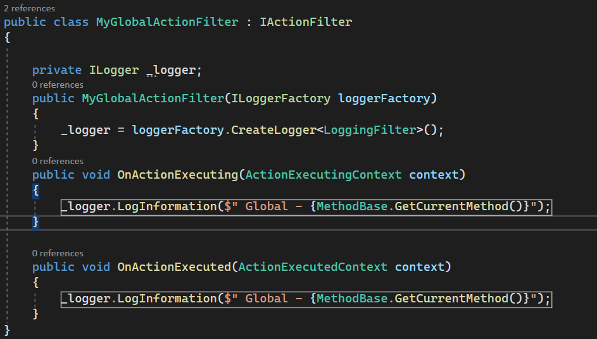
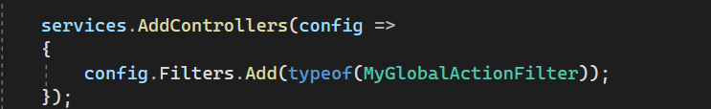
CONTROLLER LEVEL FILTERS
1

Slide 35
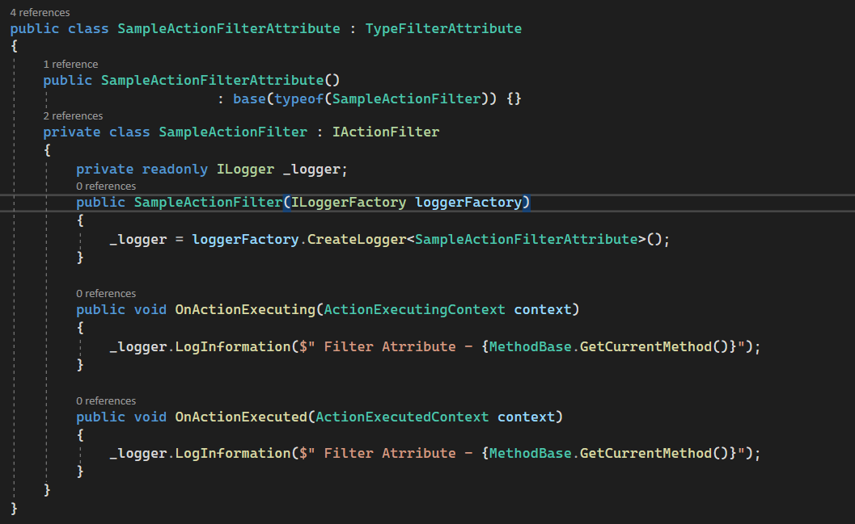
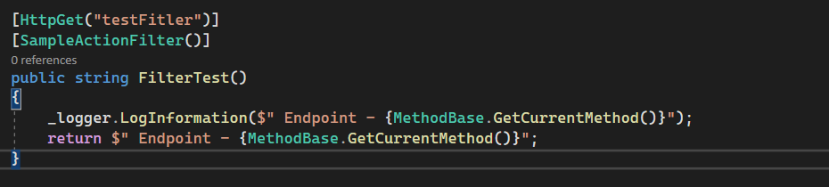
CONTROLLER LEVEL FILTERS
2

Slide 36
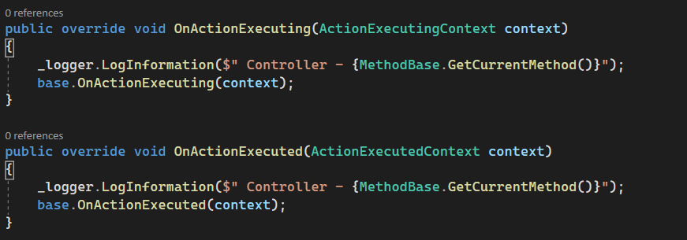
CONTROLLER LEVEL FILTERS
3

Slide 37
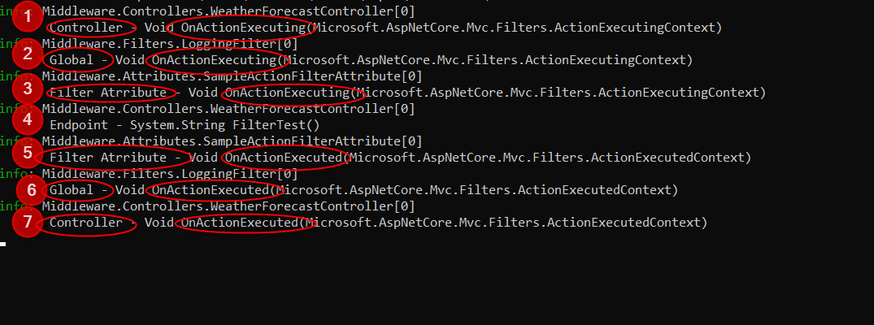
CONTROLLER LEVEL FILTERS
Notes:
Demo case change Order. Can change global and Filter attribute only

Slide 38
FILTERS as DI
For the filters that are implemented as Attribute and add directly to the controller or action methods, cannot have constructor dependencies. Because:
Attributes must have their constructor parameters supplied where they're applied.
This is a limitation of how attributes work.
Solution to deal with this limitation:
ServiceFilterAttribute
TypeFilterAttribute
IFilterFactory

Slide 39
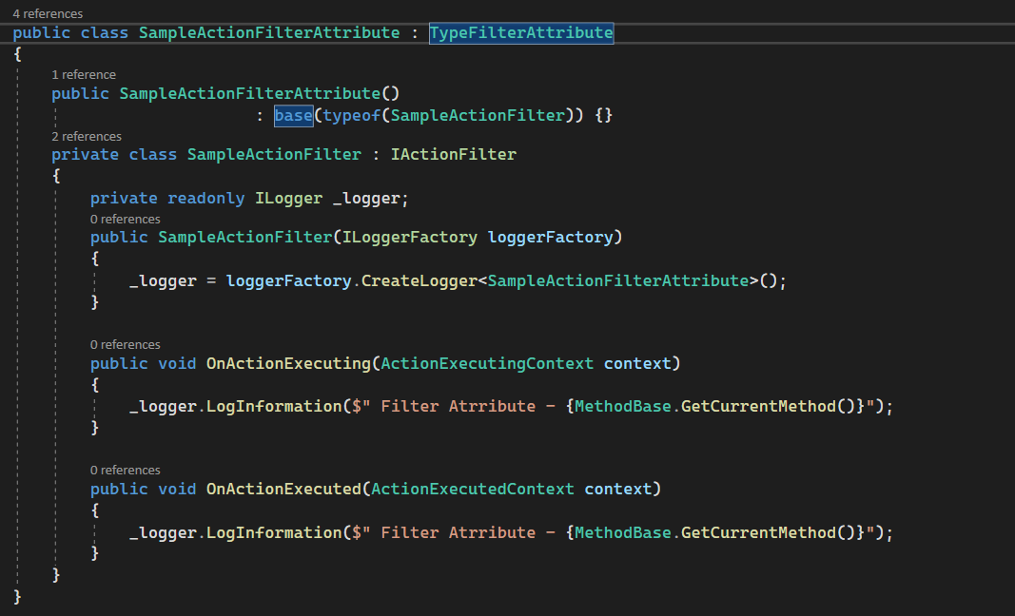
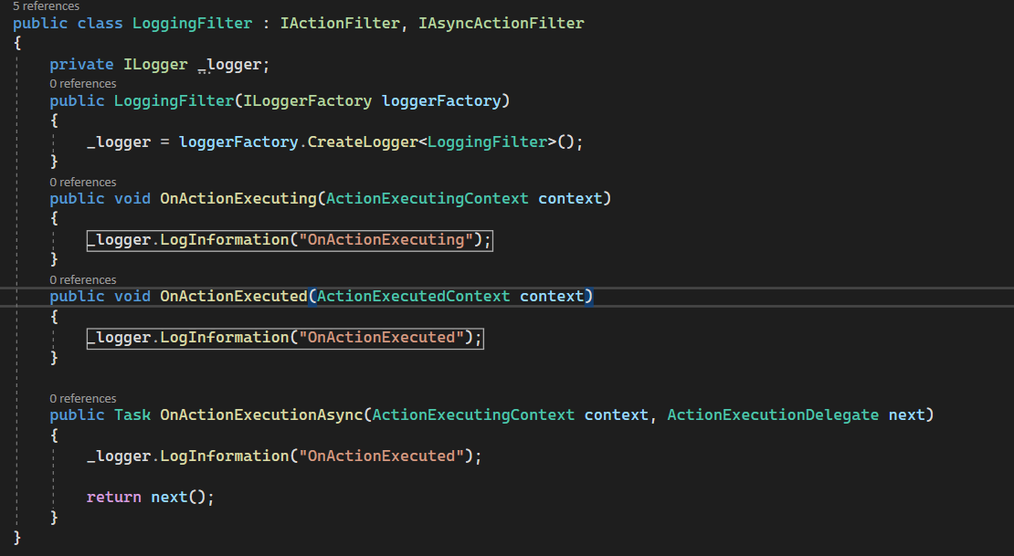
TypeFIlterAtrribute, ServiceFilterAttribute

Slide 40
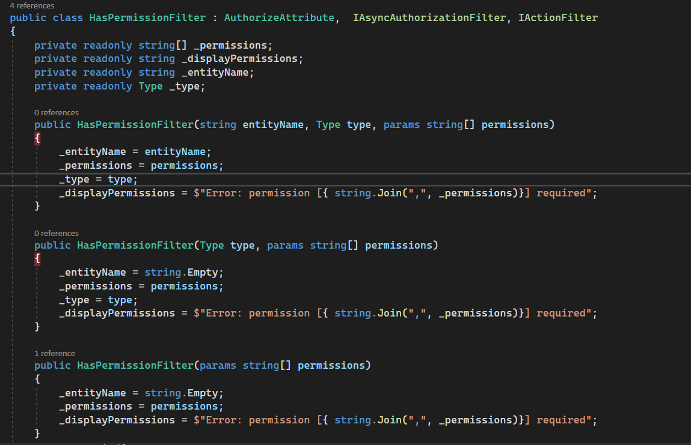
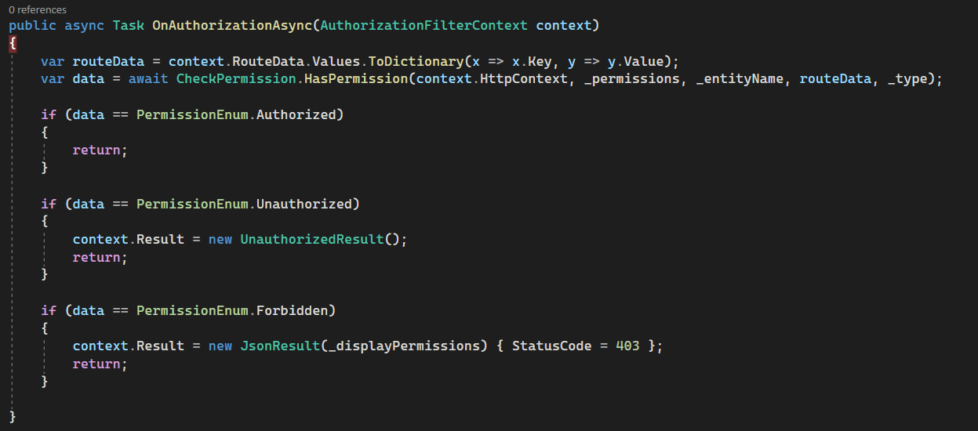
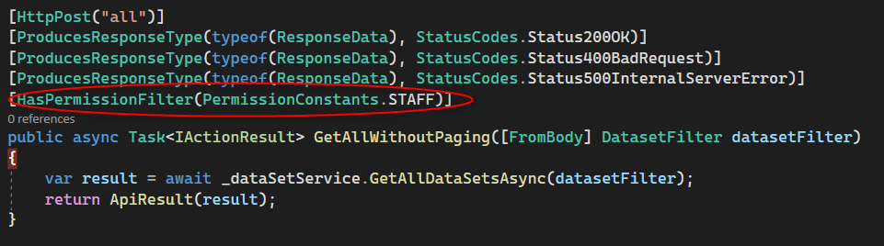
FILTERS - PRACTICAL APPLICATION 1

Slide 41
FILTERS - PRACTICAL APPLICATION 2
Scenario:
Define Global filter which apply to all action methods.
But based on specific business, some action don’t want to apply this Filter.
How could we deal with this suitation dynamically?
Possible solution:
Define another Attribute/Filter (like IgnoreStatusAttribute) and apply to particular action. Then in global filter check if this filter is applied, we ignore the logic for this one.
The context also give information about the routing. We could check based on the path.

Slide 42
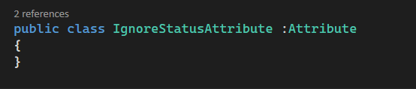
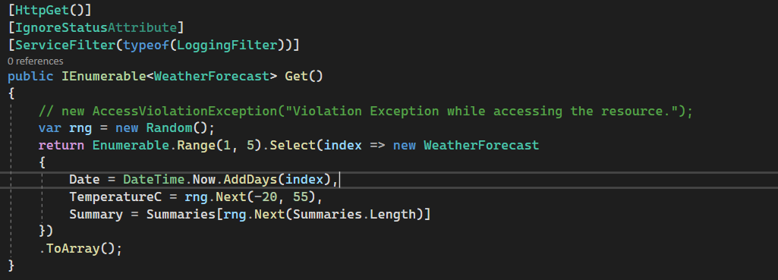
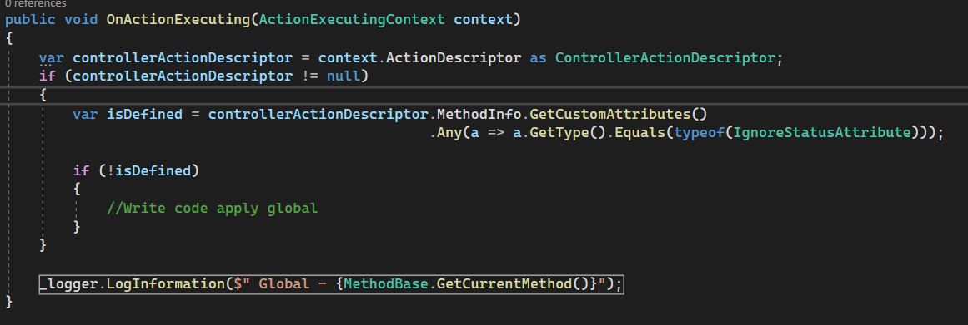
FILTERS - PRACTICAL APPLICATION 2

Slide 43
MIDDLEWARE vs FILTER
Similarities:
“in” - “out”
Through middleware.
Filters also two-way (resource, action, result).
Short-circuit
Middleware can short-circuit by returning a response.
Filters can also short-circuit the Filter pipeline
Croscutting concerns
Middleware: Logging, exception handling
Filter also lend themselves crosscutting
Notes:
Requests pass through a middleware component on the way “in” and responses pass through again on the way “out”. Resource, action, and result filters are also two-way, though authorization and exception filters run only once for a request.
Middleware can short-circuit a request by returning a response, instead of passing it on to later middleware. Filters can also short-circuit the MVC filter pipeline by returning a response.
Middleware is often used for crosscutting application concerns, such as logging, performance profiling, and exception handling. Filters also lend themselves to crosscutting concerns.

Slide 44
MIDDLEWARE vs FILTER
Differences:
Filter | Middleware
Filters will only run for requests that reach MvcMiddleware | Can run for all requests
Filters have access to MVC constructs such as ModelState and IActionResults | Middleware independent from MVC, so can’t use these concepts
Filters can be easily applied to a subset of requests. For example, all actions on a single controller | Middleware doesn’t have this concept as a first-class idea.
Notes:
(though you could achieve something similar with custom middleware components)
Filters can be easily applied to a subset of requests; for example, all actions on a single controller.

Slide 45
MIDDLEWARE vs FILTER
Use Middleware when :
The functionality has no MVC- specific requirements
Best practice for this is Exception handling
Use Filter when :
The functionality need to access MVC constructs such as ModelState, ActionResult
Need different behavior for different action methods
Notes:
I like to think of middleware versus filters as a question of specificity

Slide 46
ASP.NET CORE
APPLICATION SETTINGS & CONFIGURATION

Slide 47
APPLICATION SETTINGS & CONFIGURATION
Read configuration data from Key-value
Appsettings.json used to contains keys and values for storing database connection strings, global variables and other configuration values.
Never store passwords or other sensitive data in configuration provider code or in plain text configuration files. The Secret Manager tool can be used to store secrets in development.

Slide 48
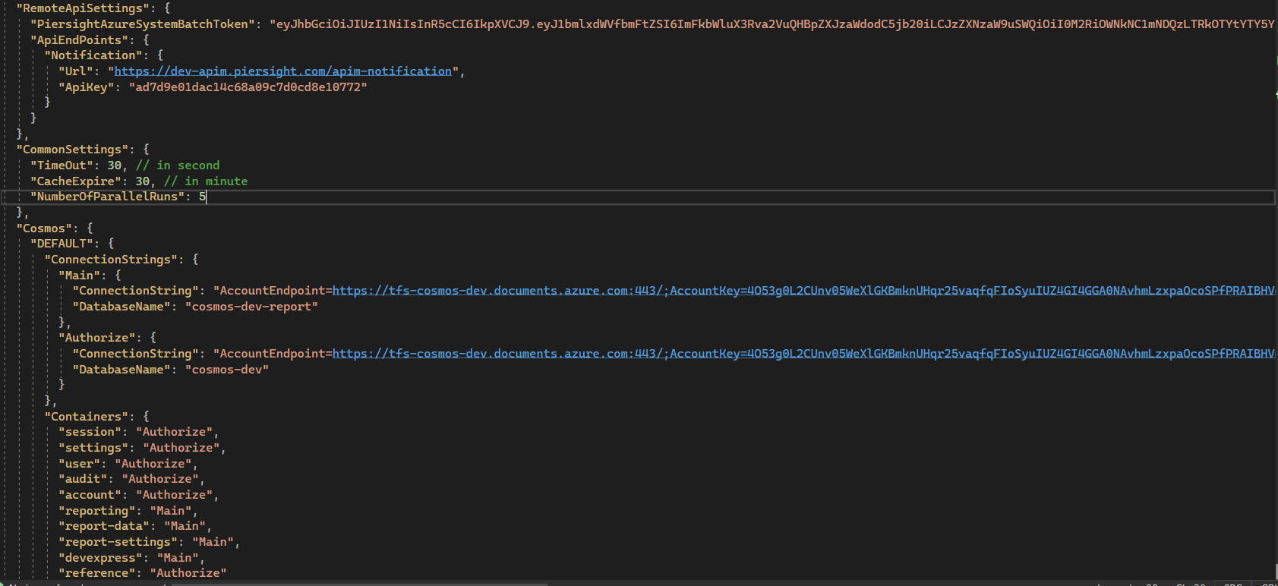
APPLICATION SETTINGS & CONFIGURATION

Slide 49
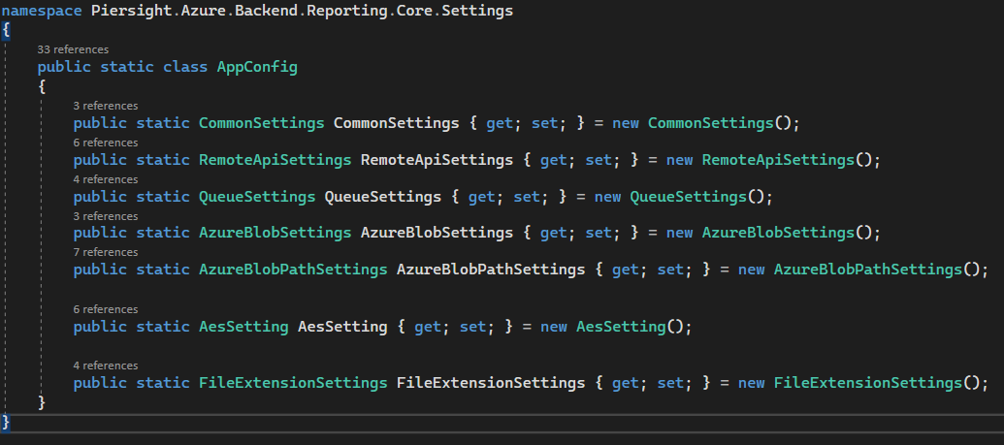
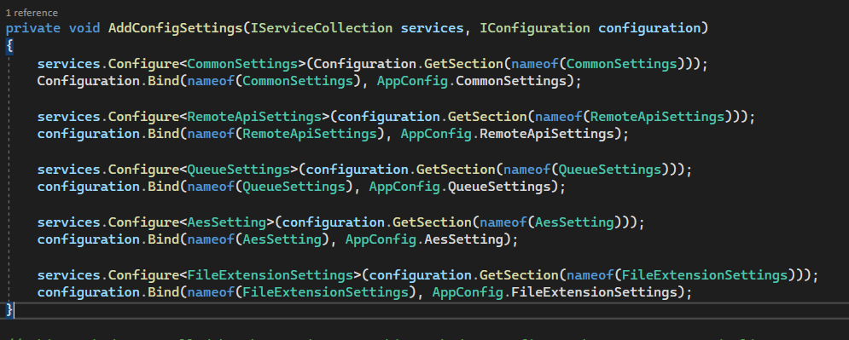
USE CONFIGURATION TO READ DATA
Based on configuration, create perspective class
Register in startup
Get the config via Confiugration

Slide 50
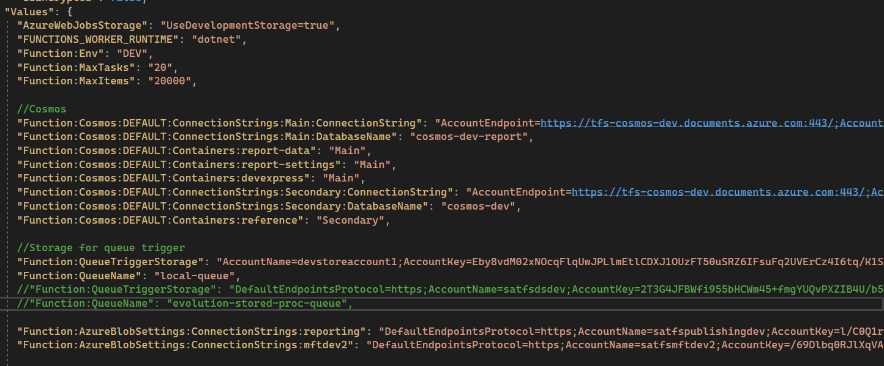
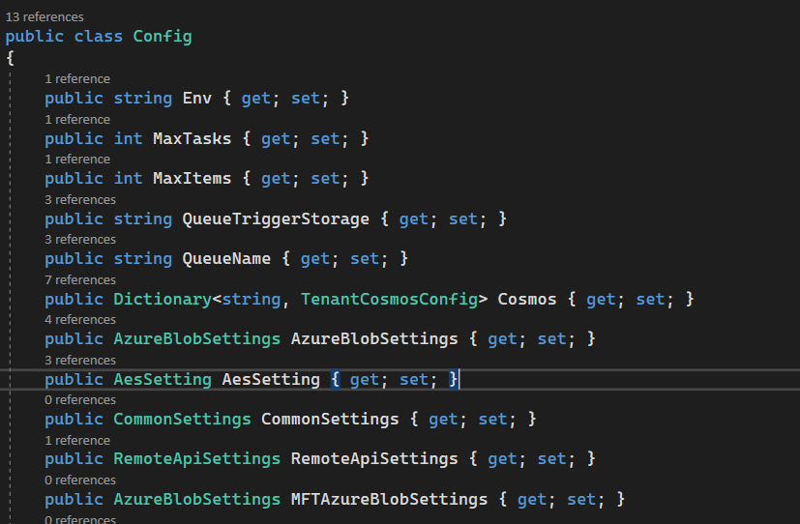
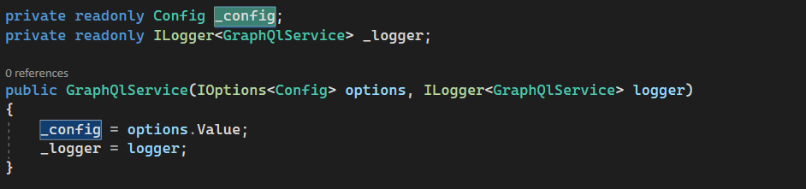
OPTION PATTERN

Slide 51

DEMO

Slide 52
Q&A

Slide 53
THANK YOU!

